Slide 1
Predicting Multivitamin Purchase
Team Hustle Squad
Katta Manaswini Reddy-22WH1A1296
Rabiya Warsi-22WH1A12A0
Krishna Priya Kanduri-22WH1A12A8
Chiluka Akshitha-22WH1A12B5

Slide 2
Who, What and Why your ML Model
Who is going to be benefited and what is the benefit Your ML Model ?
Healthcare providers: Gain insights into consumer preferences for medicines and health products.
Consumers: Receive personalized product recommendations and potentially lower prices based on market trends.
Pharmaceutical companies: Optimize inventory management and pricing strategies based on real-time market data.
Why Machine Learning programming is needed to solve the problem ?
Complexity: Analyzing vast amounts of healthcare and consumer data requires advanced algorithms to extract meaningful insights.
Prediction: Machine learning models can forecast demand, pricing trends, and consumer behavior accurately.
Optimization: Automates decision-making processes for inventory and pricing, leading to more efficient operations.

Slide 3
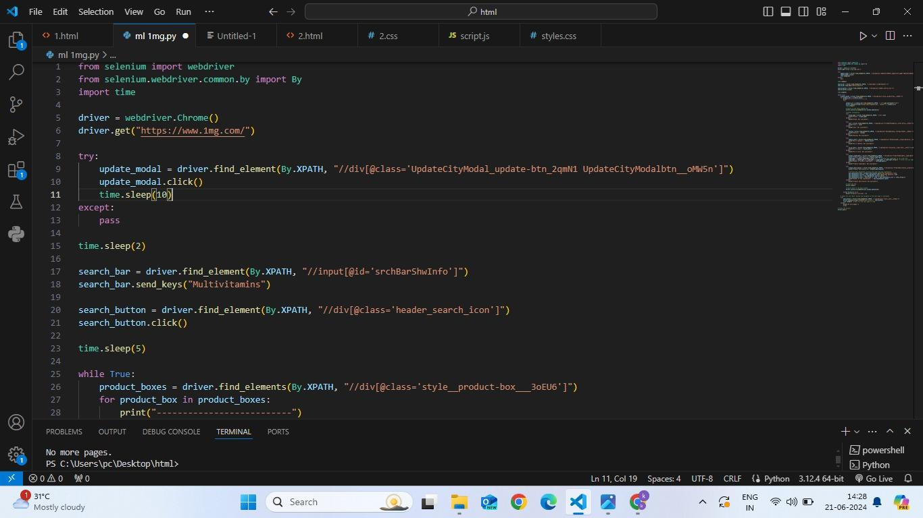
Code:
https://github.com/AKSHITHA-CHILUKA/projects/blob/main/Predicting%20Multivitamine%20Purchase

Slide 4
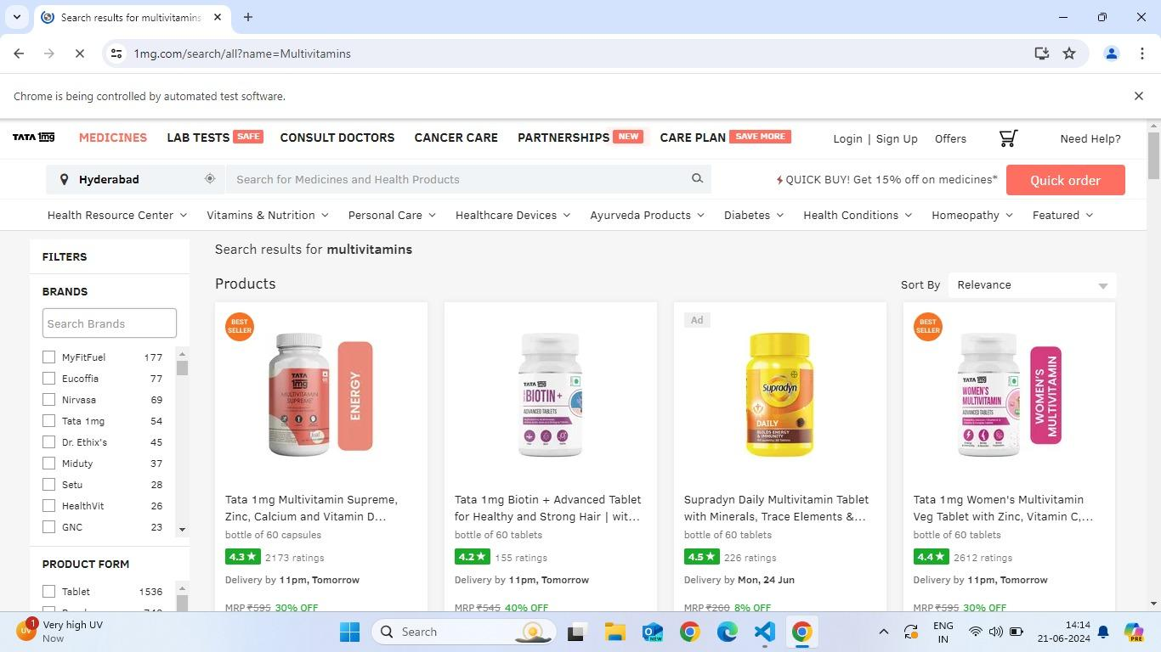
1MG data scraping:

Slide 5
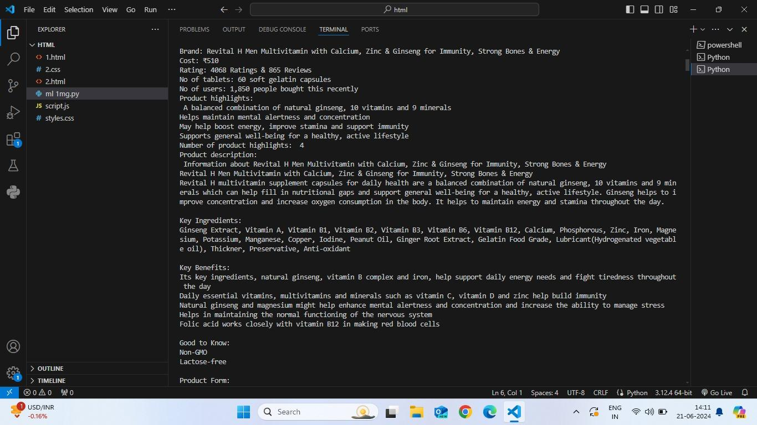
Scraping data using selenium from 1MG:

Slide 6
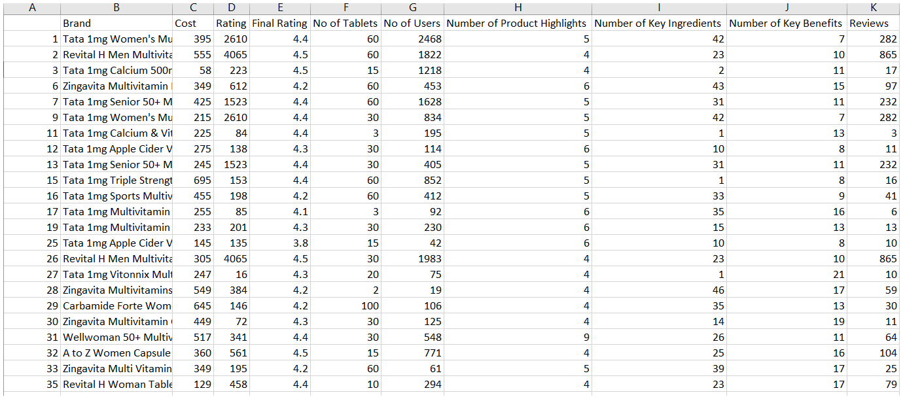
Mulivitamins.csv

Slide 7
Where and How the dataset is collected ?
Selenium is used to scrape the data 1mg Website .
How many pages and how many web elements in each pages had to be scrapped. -Scraped data from approximately 5 pages on the 1mg website.
What techniques of Selenium had to be used:
-Utilized XPath for precise element selection.
-Implemented explicit waits to handle dynamic content loading effectively.
What special conditions or problems were faced and how did you overcome them when scraping?
-Dynamic Content Loading: Addressed by employing explicit waits to ensure all necessary elements fully loaded before scraping.
Any web services used to collect the data ?
-Solely relied on Selenium for scraping data; no additional web services or APIs were integrated.

Slide 8
Data Transformations and Data Cleansing needed on the Collected Data
Data Transformations List:
-Created new features from existing ones.
Data Cleaning List:
-Removed rows or columns with missing values if they are not significant.
-Removed duplicate rows in the dataset.
Data Merging:
-Only one dataset is being used, so no merging operations are required.
-After cleaning and transforming the data, we ensured that all operations have been correctly applied and the dataset is ready for model training.

Slide 9
How is your Data Set accessible to others
What is the Blob Storage URL from Azure Cloud for a particular version of Data Set used for model training. Is this available for anonymous users ?
https://multivitamins1504032067.blob.core.windows.net/azureml-blobstore-37059c79-f357-456f-8d30-b55202ec02b4/UI/2024-06-12_093029_UTC/vitamins_new (1).csv
https://drive.google.com/file/d/1zxxy7rhJW-XrlHnJO8pjDMsfaFAlRmCL/view?usp=drive_link
It is private .
Did you create any web-service to update this data set ?
-No,We did not use any additional web services or APIs alongside Selenium

Slide 10
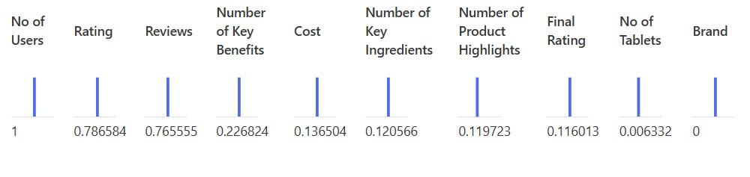
Features of the dataset:

Slide 11
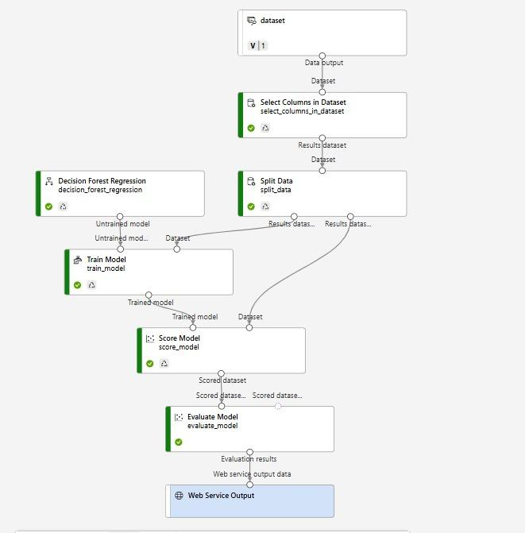
What Features were found to have an impact on the target variable ?
Paste the graph or values that you have seen in the
outputs with ‘Explanation” set to true from the decision
forest regression train model pipeline ?
Did you drop or improve your data based on this
feature explanations ?
Yes we dropped 2 columns .

Slide 12
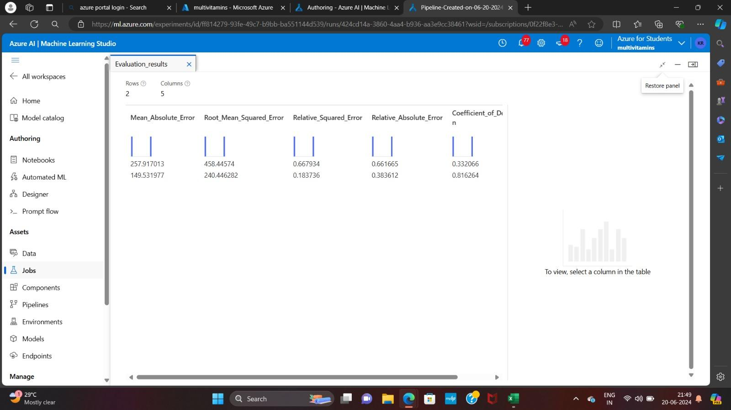
Output:

Slide 13
What are the evaluation metrics for the different ML algorithms you tried
S.No | Algo Name | Relative AE | MAE | R2 | RMSE
1 | Decision forest regression | 0.383612 | 149.531977 | 0.183736 | 240.446282
2 | Boosted decision tree regression | 0.361185 | 169.768451 | 0.189952 | 274.415569
3 | linear regression | 0.661665 | 257.917013 | 0.667934 | 458.44574
4 | - | - | - | - | -

Slide 14
Model Accuracies Fine Tuning
What steps did you take to improve the accuracy of your ML model ?
-By removing duplicates and outliers.
How much improvement did you observe in terms of the evaluation metrics
-Initially we got accuracy near to 0.5 and at the end it improved to 0.8
Is your model over fitted or under fitted ?
-over fitted

Slide 15
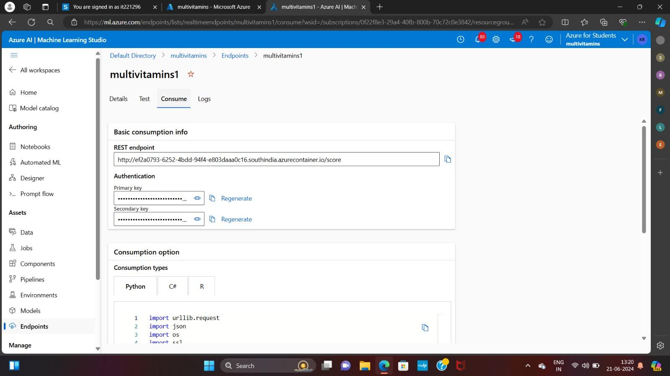
Endpoints:

Slide 16
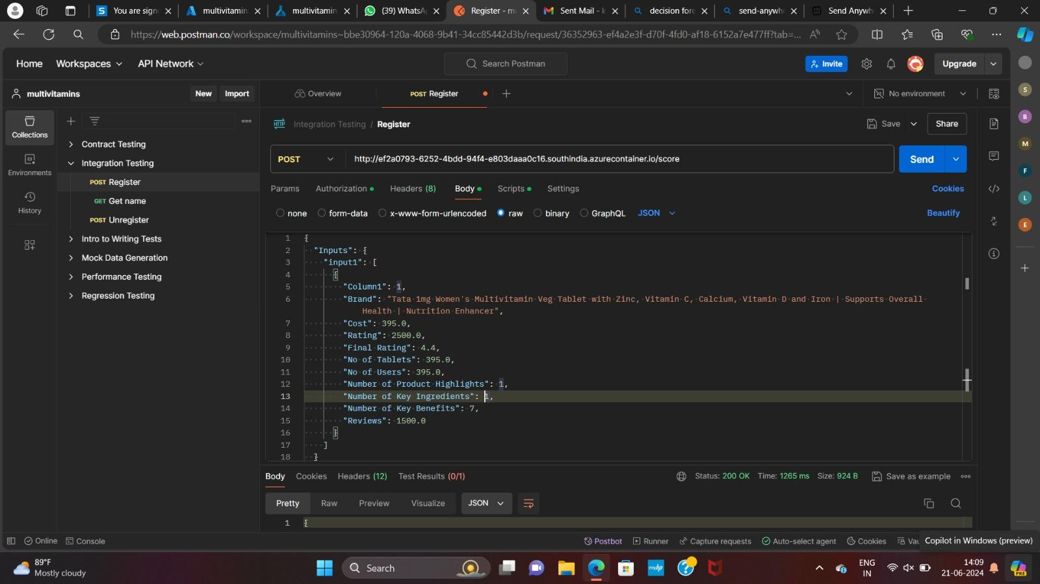
Postman Outputs:

Slide 17
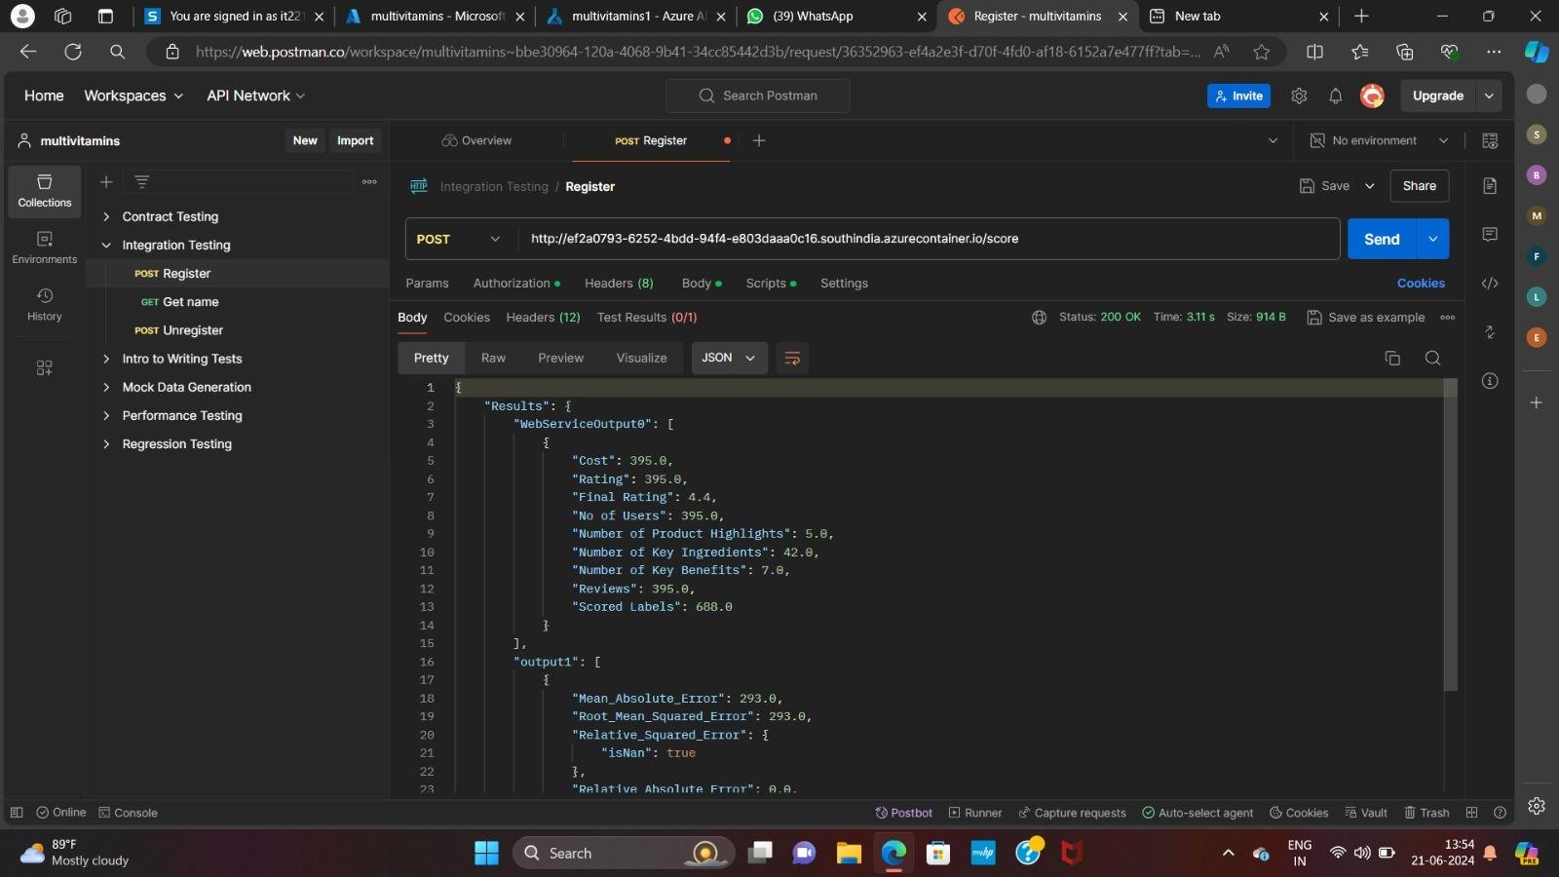
Postman Outputs:

Slide 18
Inference and Model Deployment
What is the endpoint url for the final deployed inferencing pipeline:
http://ef2a0793-6252-4bdd-94f4-e803daaa0c16.southindia.azurecontainer.io/score

Slide 19
Thank You

